Slide 1
Introduction to QuantLib C++ source code and basic classes
Introduzione all’Ingegneria Finanziaria Seminario Professionalizzante
Vincenzo Eugenio Corallo, Ph. D
Sapienza Università di Roma
vincenzo.corallo@uniroma1.it

Slide 2
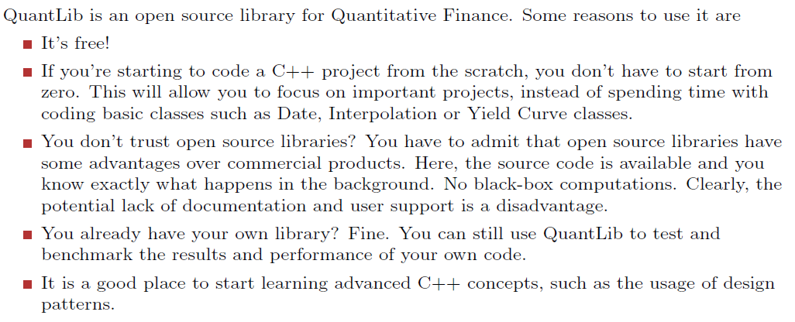
Why should I use QuantLib?

Slide 3
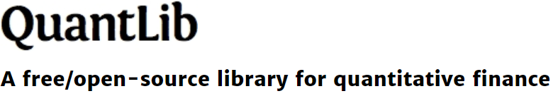
Installation instruction
Detailed instructions for installing QuantLib are available at https://www.quantlib.org/install/vc10.shtml

Slide 4
Boost C++ libraries (optional)
For the sake of installing QuantLib and run the source code it would be required to install the Boost libraries first. Boost is a set of libraries for the C++ programming language that provide support for tasks and structures such as linear algebra, pseudorandom number generation, multithreading, image processing, regular expressions, and unit testing. It contains 160 individual libraries (as of version 1.72).
Most of the Boost libraries are licensed under the Boost Software License, designed to allow Boost to be used with both free and proprietary software projects. Many of Boost's founders are on the C++ standards committee, and several Boost libraries have been accepted for incorporation into the C++ Technical Report 1, the C++11 standard (e.g. smart pointers, thread, regex, random, ratio, tuple) and the C++17 standard (e.g. filesystem, any, optional, variant, string_view).

Slide 5
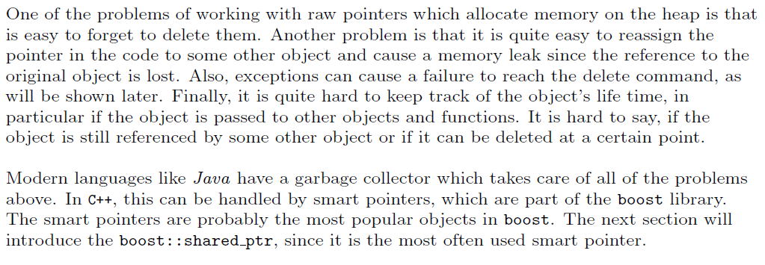
Boost shared pointers (optional)

Slide 6
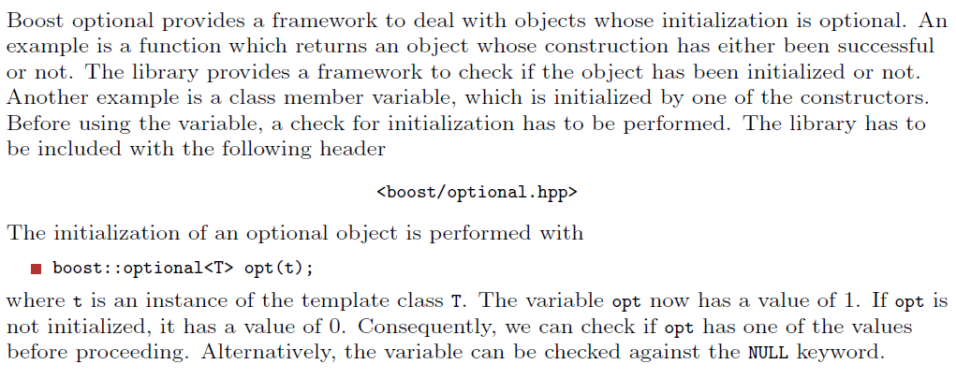
Boost optional (optional)

Slide 7
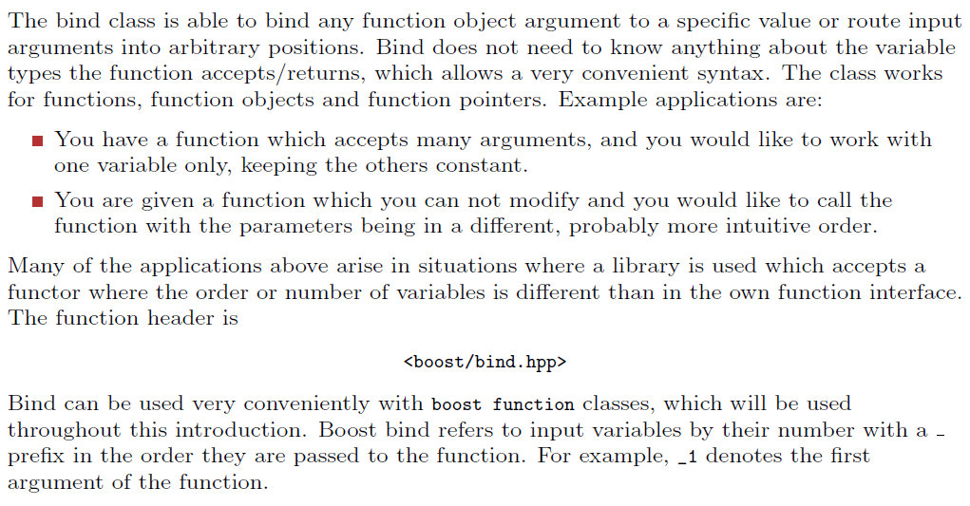
Boost bind (optional)

Slide 8
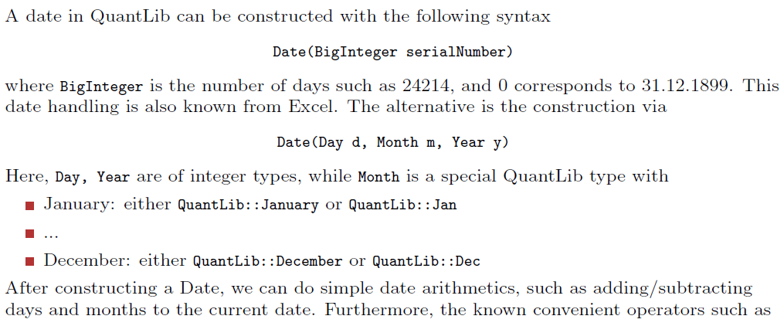
Dates in QuantLib - 1

Slide 9
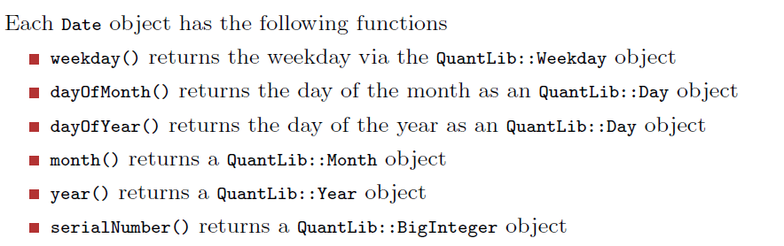
Dates in QuantLib - 2

Slide 10
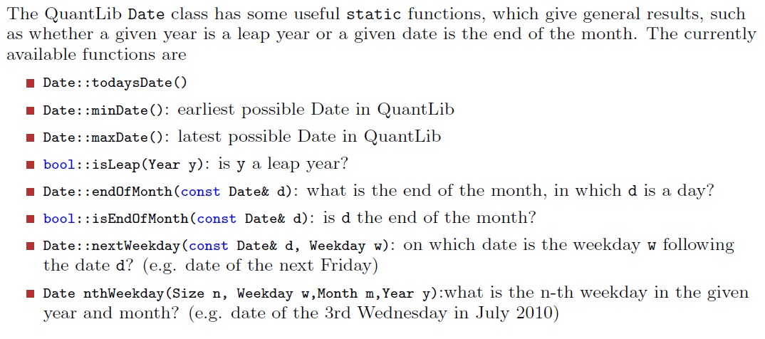
Dates in QuantLib - 3

Slide 11
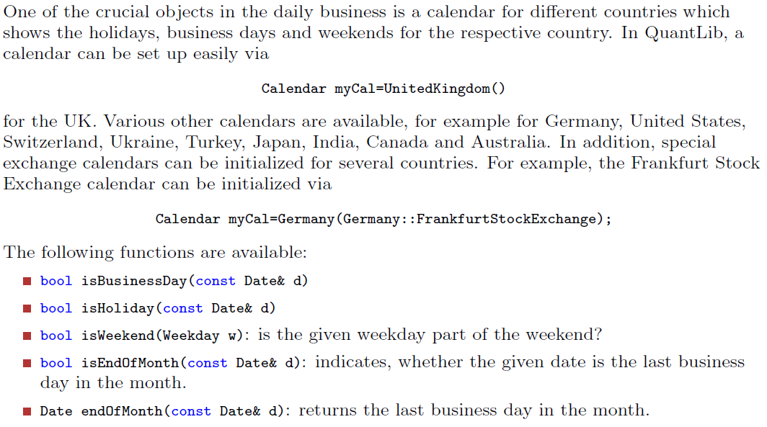
Calendars in QuantLib - 1

Slide 12
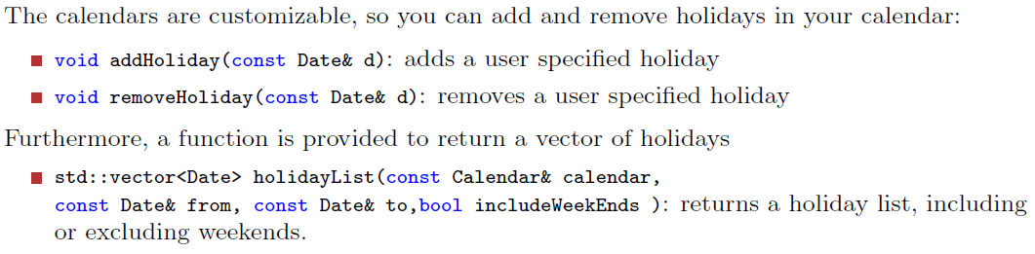
Calendars in QuantLib - 2

Slide 13
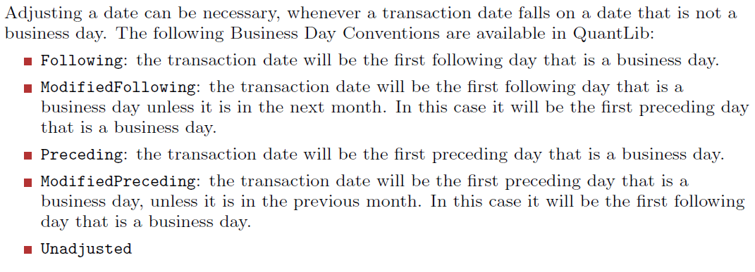
Business Day Conventions in QuantLib - 1

Slide 14
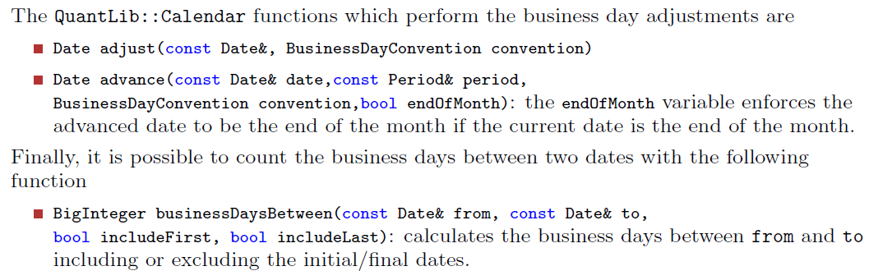
Business Day Conventions in QuantLib - 2

Slide 15
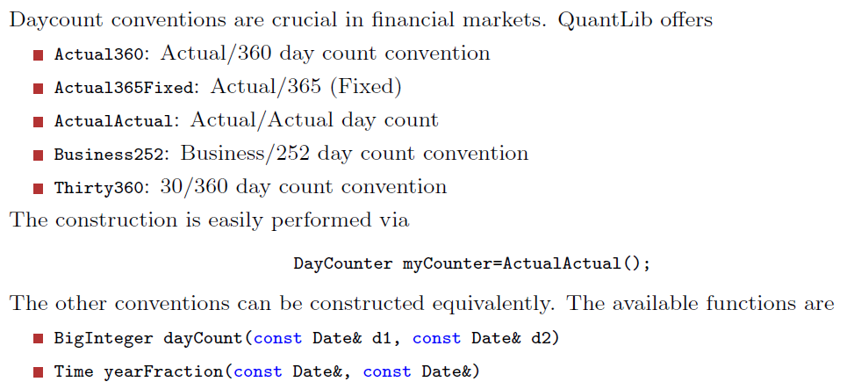
Daycount Conventions in QuantLib

Slide 16
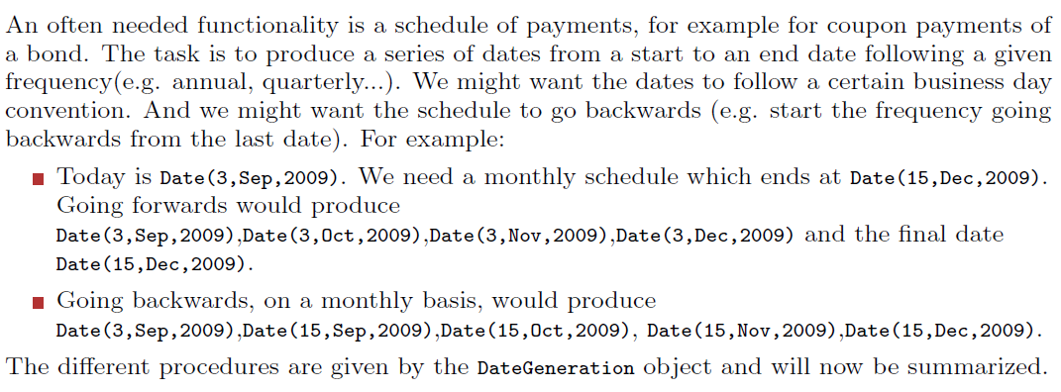
Payments Scheduling in QuantLib - 1

Slide 17
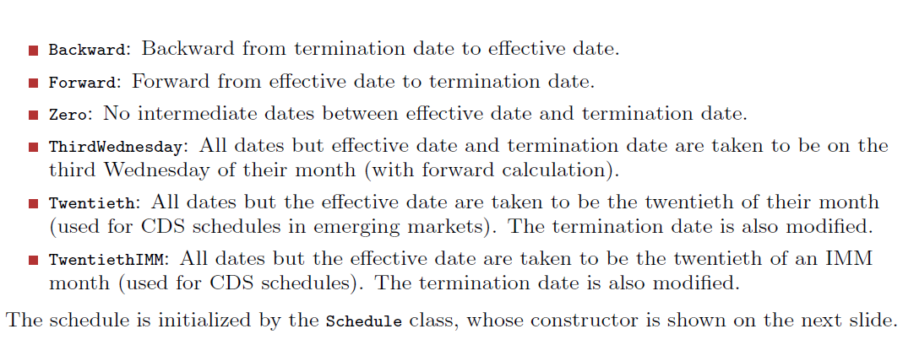
Payments Scheduling in QuantLib - 2

Slide 18
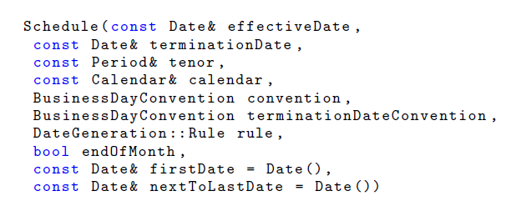
Schedule Constructor – Example invoke

Slide 19
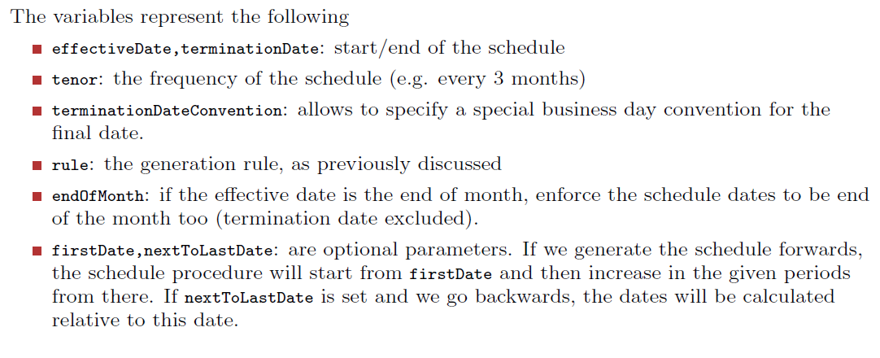
Payments Scheduling in QuantLib - 3

Slide 20
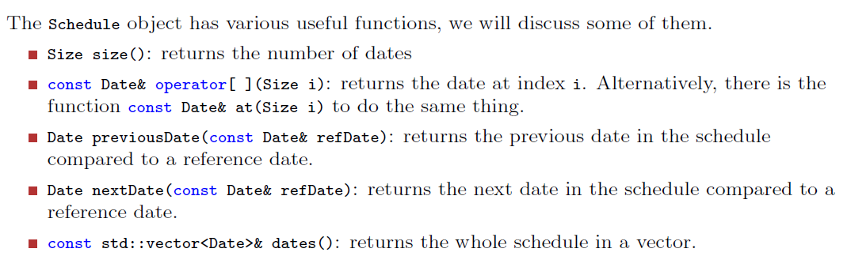
Payments Scheduling in QuantLib - 4

Slide 21
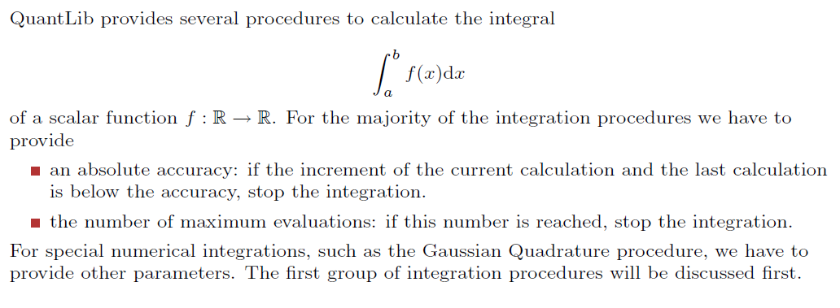
Numerical Integration in QuantLib

Slide 22
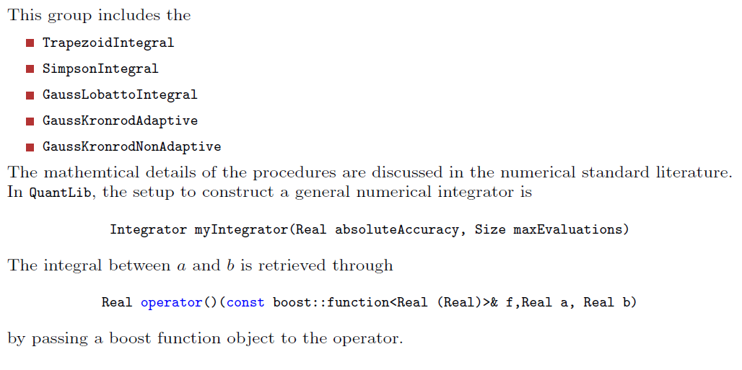
Numerical Integration via Gaussian Quadrature – 1

Slide 23
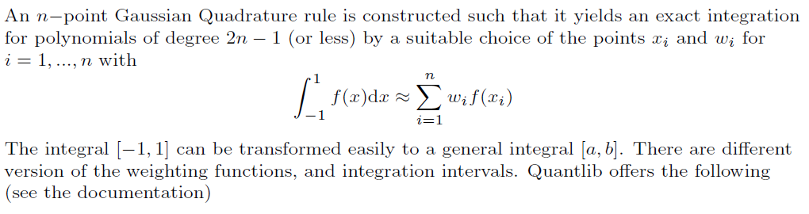

Numerical Integration via Gaussian Quadrature – 2

Slide 24
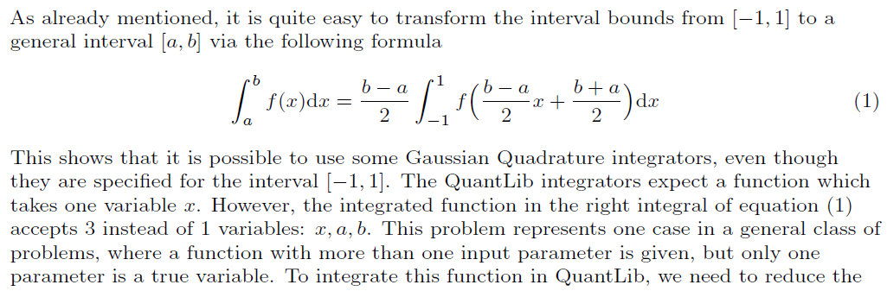
Numerical Integration via Gaussian Quadrature – 3

Slide 25
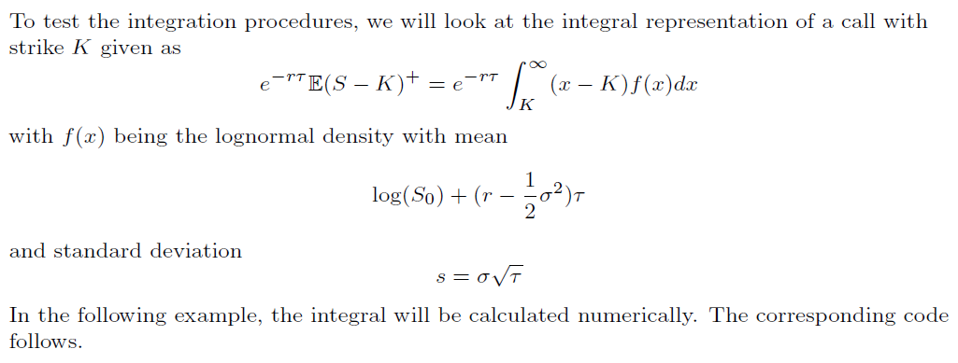
Gaussian Quadrature Integration Example – 1

Slide 26
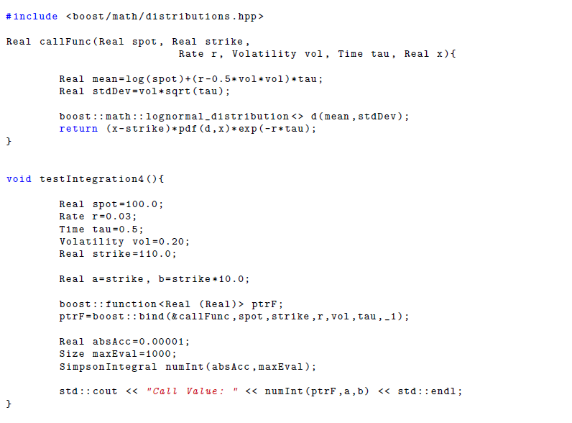
Gaussian Quadrature Integration Example – 2

Slide 27
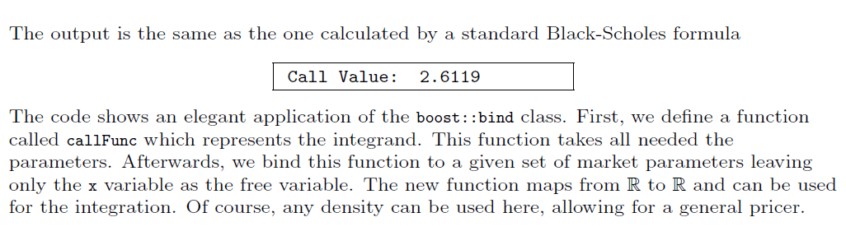
Gaussian Quadrature Integration Example – 3

Slide 28
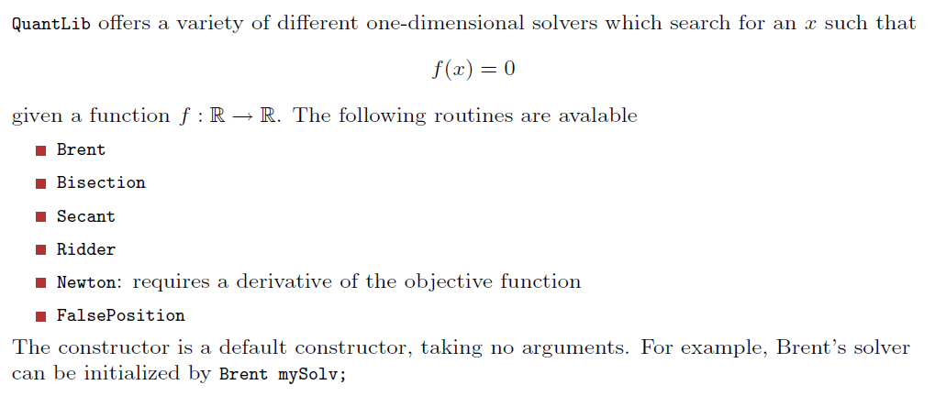
Solvers in QuantLib - 1

Slide 29
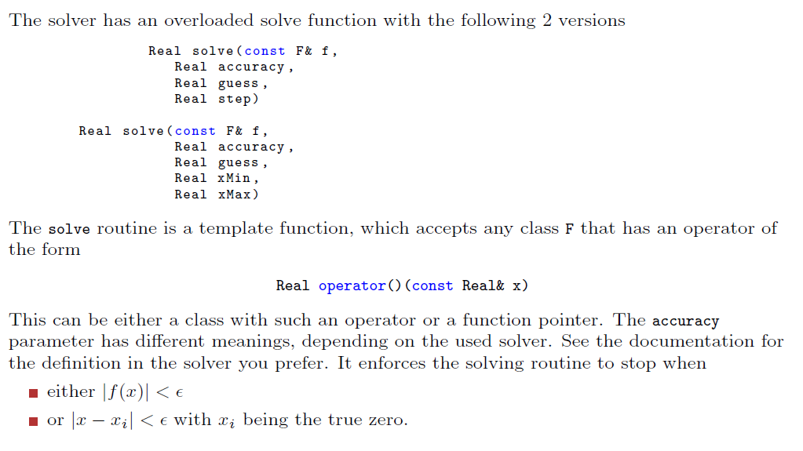
Solvers in QuantLib - 2

Slide 30
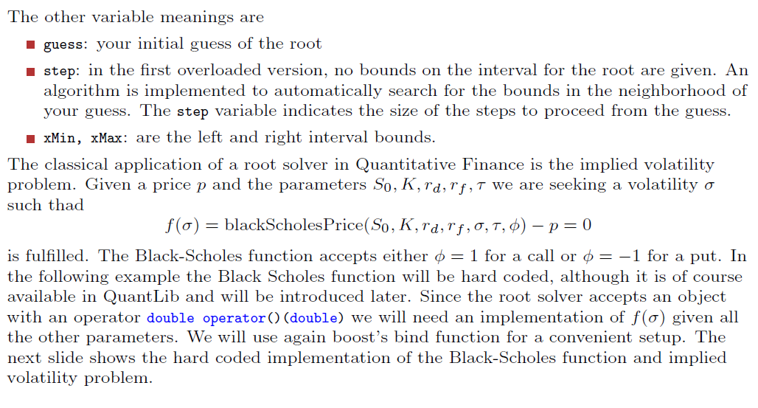
Implied Volatiliy via solvers - Example

Slide 31
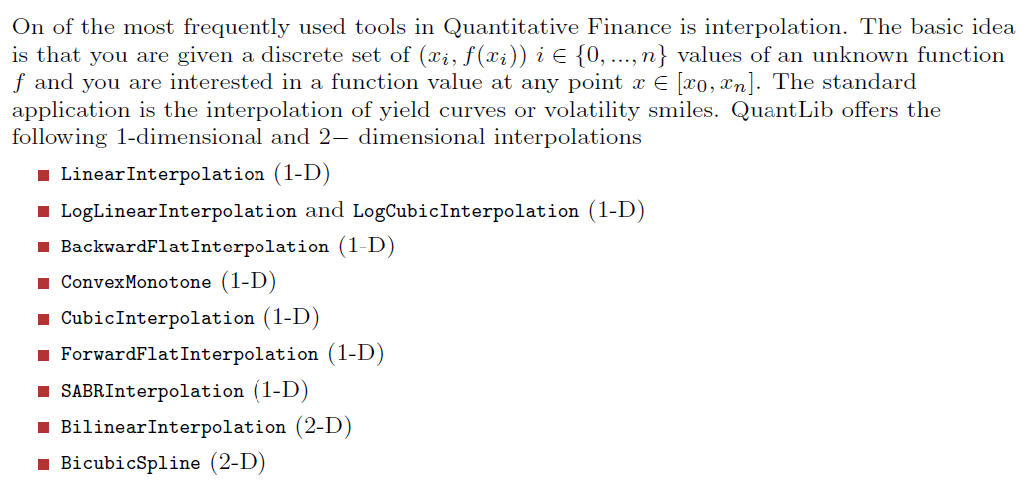
Interpolation in QuantLib - 1

Slide 32
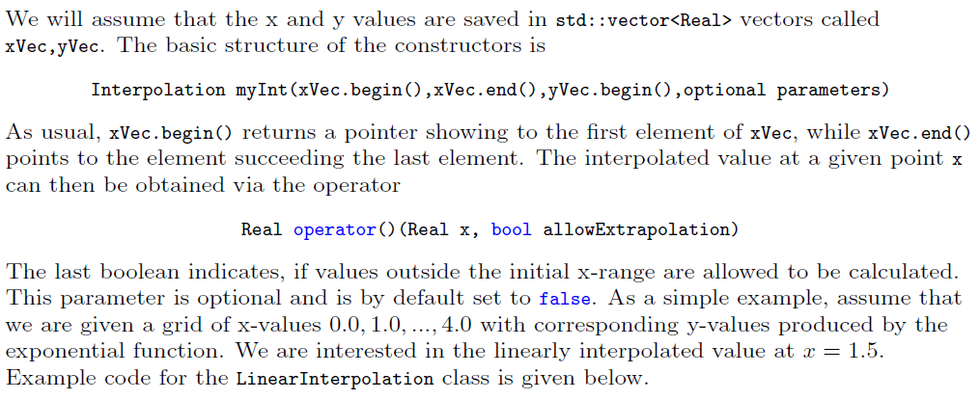
Interpolation in QuantLib - 2

Slide 33
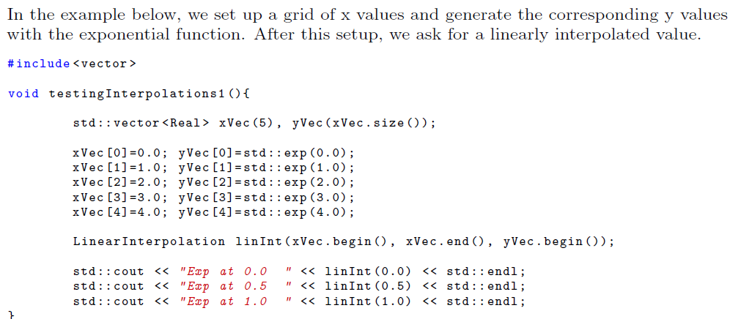
Linear Interpolation Example - 1

Slide 34
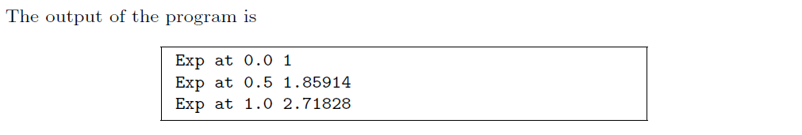
Linear Interpolation Example - 2

Slide 35
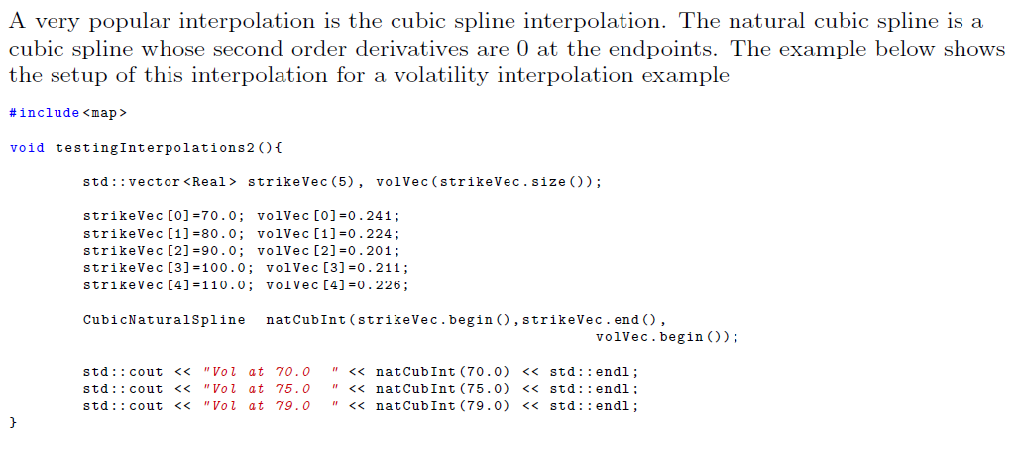
Cubic Splines Interpolation Example - 1

Slide 36
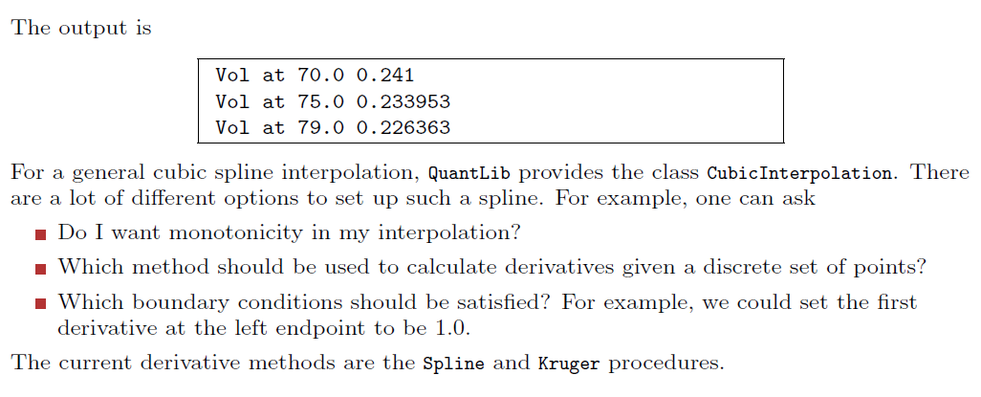
Cubic Splines Interpolation Example - 2

Slide 37
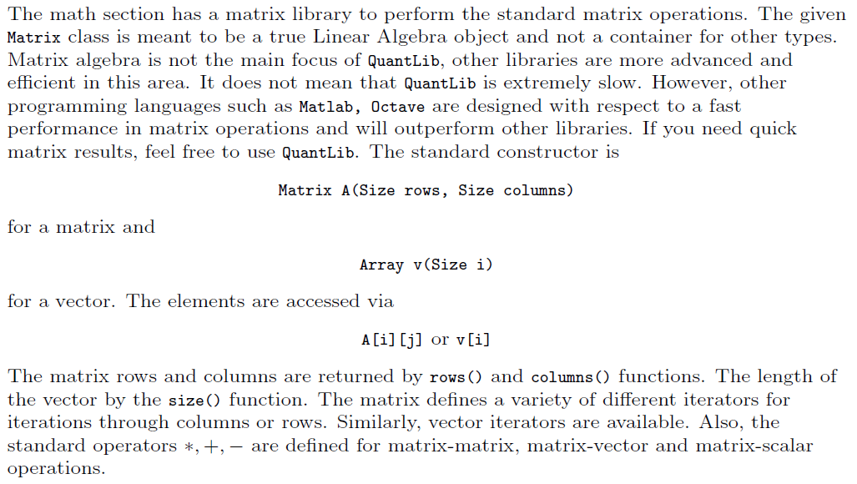
The Matrix class in QuantLib - 1

Slide 38
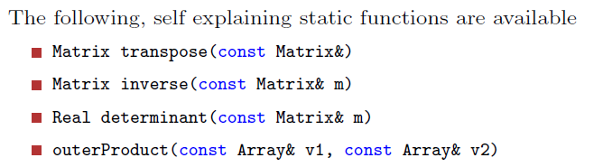
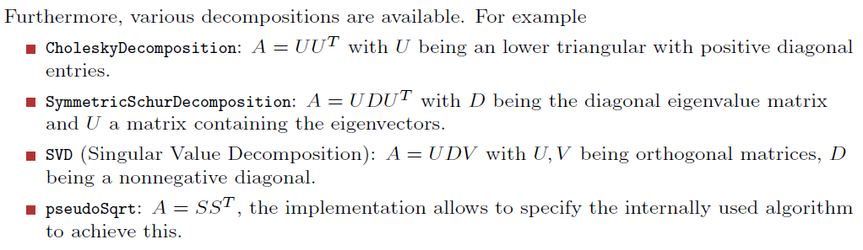
The Matrix class in QuantLib - 2

Slide 39
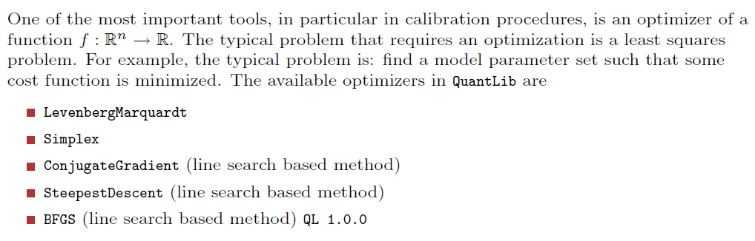
Optimization in QuantLib - 1

Slide 40
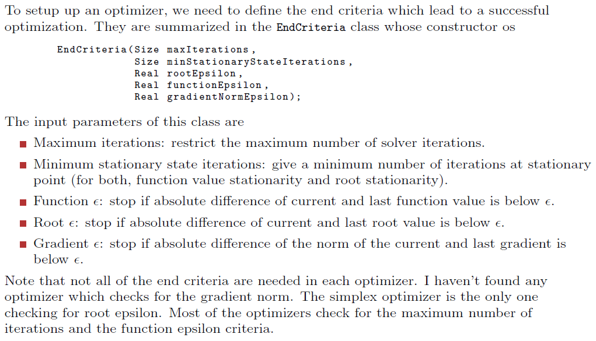
Optimization in QuantLib - 2

Slide 41
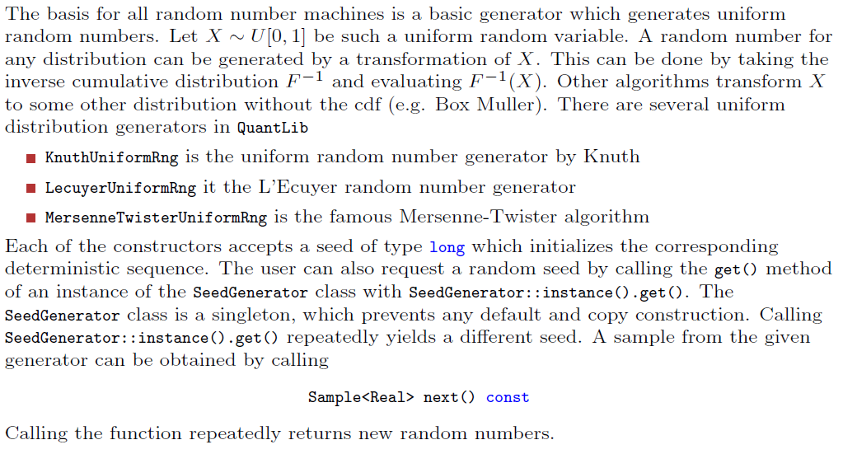
Random Numbers in QuantLib

Slide 42
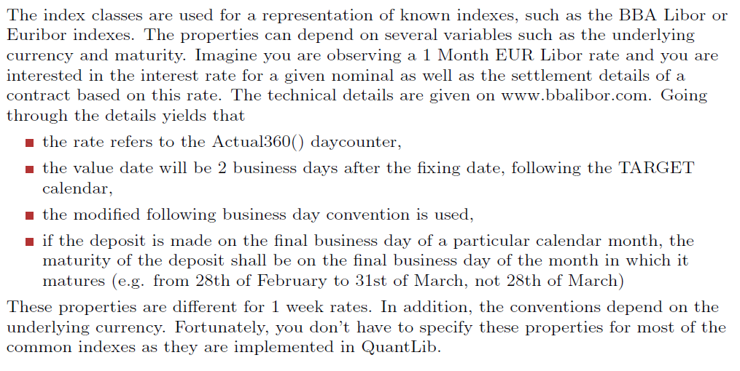
Indexes in QuantLib - 1

Slide 43
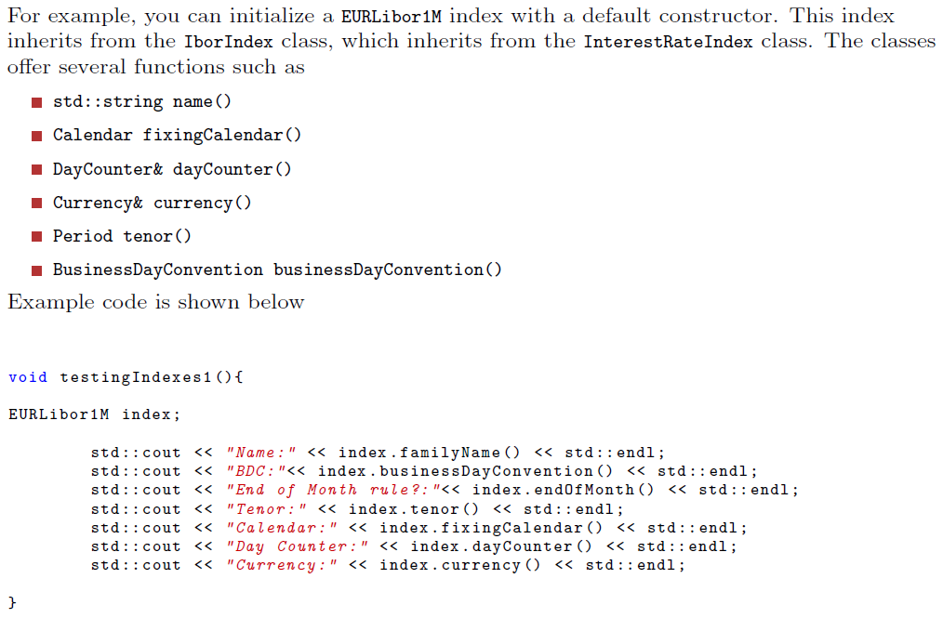
Indexes in QuantLib - 2

Slide 44
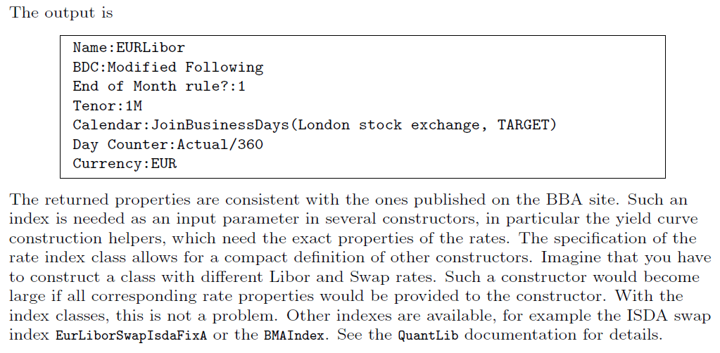
Indexes in QuantLib - 3

Slide 45
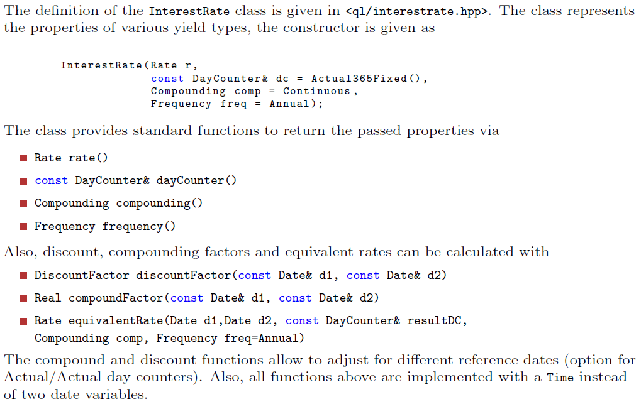
Interest Rates in QuantLib - 1

Slide 46
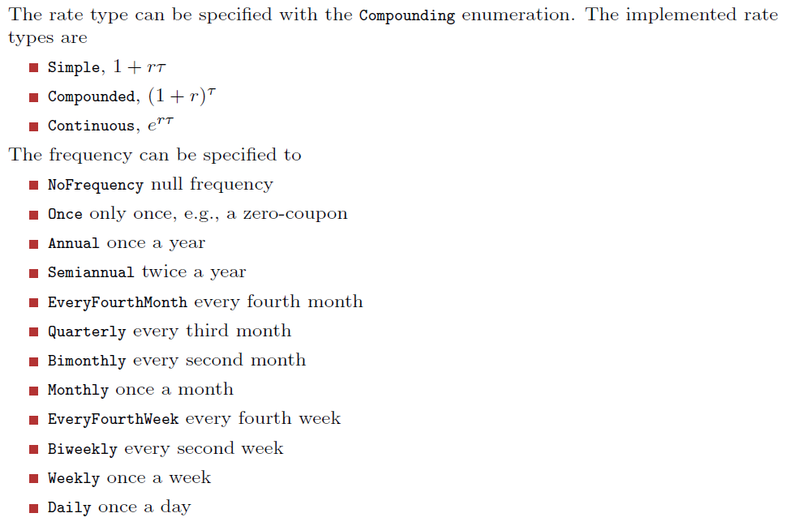
Interest Rates in QuantLib - 2

Slide 47
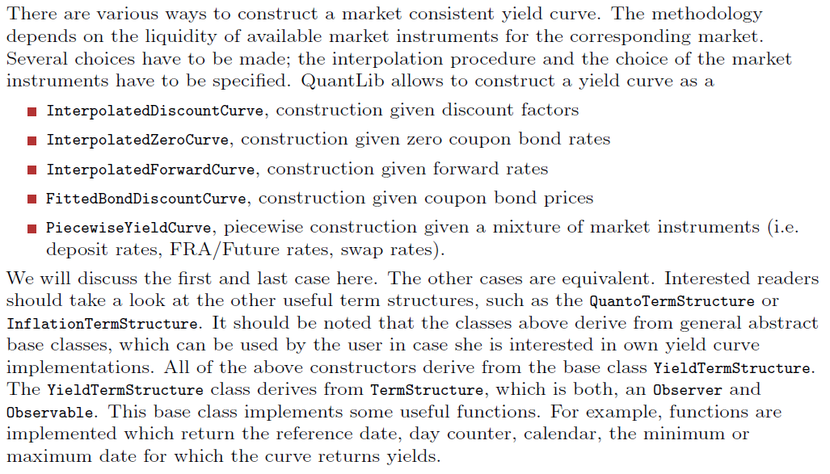
Yield Curves in QuantLib - 1

Slide 48
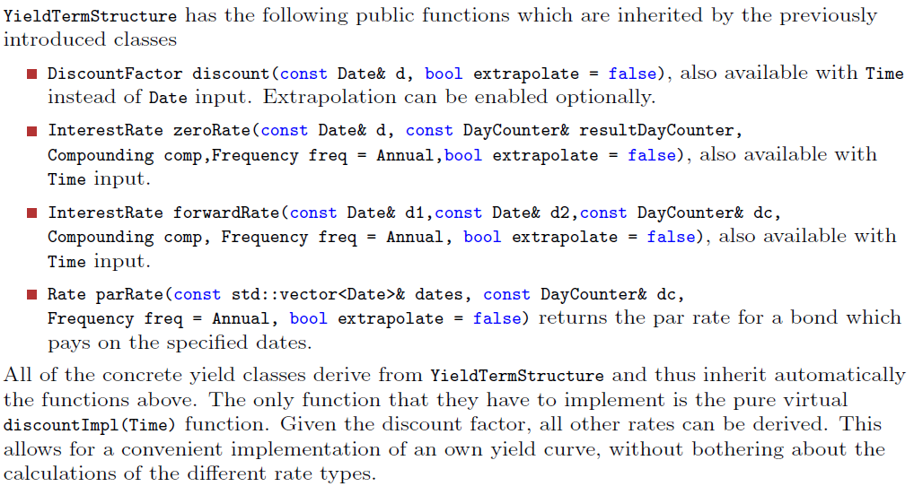
Yield Curves in QuantLib - 2

Slide 49
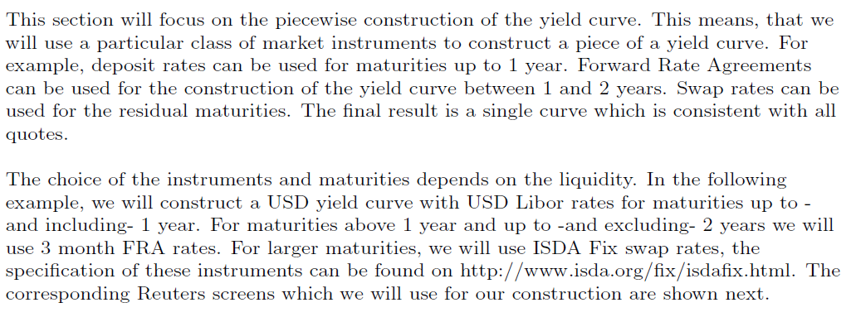
Piecewise Yield Curves Construction - 1

Slide 50
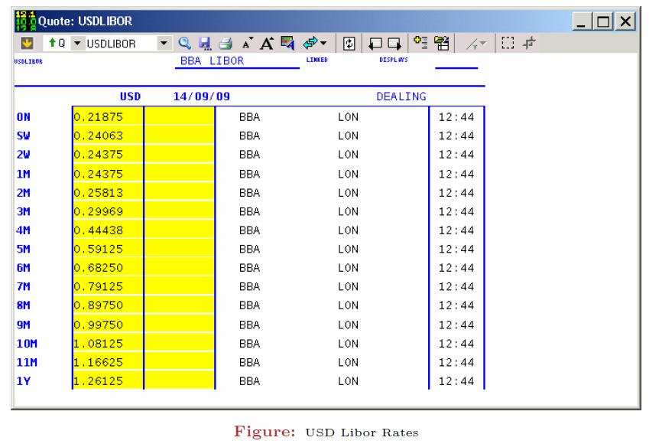
Deposit Rates

Slide 51
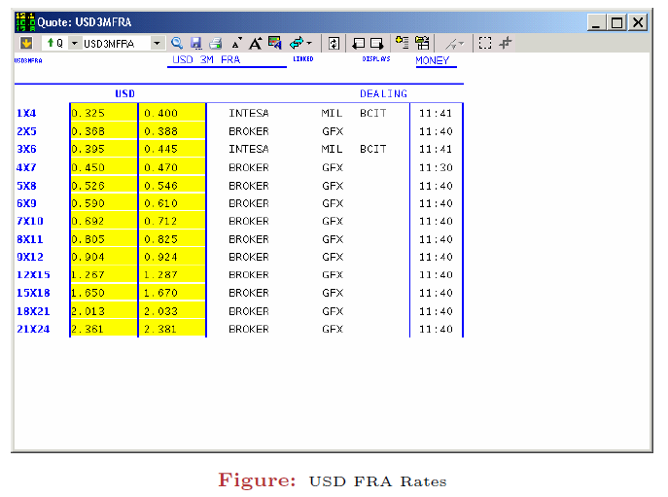
FRA Rates

Slide 52

Swap Rates

Slide 53

Piecewise Yield Curves Construction - 2

Slide 54

Payoff in QuantLib - 1

Slide 55

Payoff in QuantLib - 2

Slide 56

Exercises in QuantLib - 1

Slide 57

Exercises in QuantLib - 2

Slide 58
Processi Stocastici
Referenze
Reiswich, Dimitri (2010). Boost introduction. Available at https://www.quantlib.org/slides/dima-boost-intro.pdf
Reiswich, Dimitri (2010). QuantLib introduction, part I. Available at https://www.quantlib.org/slides/dima-ql-intro-1.pdf
Reiswich, Dimitri (2010). QuantLib introduction, part II. Available at https://www.quantlib.org/slides/dima-ql-intro-2.pdf

